Slide 1
Chapter 13:
File-System Interface

Slide 2
Outline
File Concept
Access Methods
Disk and Directory Structure
Protection
Memory-Mapped Files

Slide 3
Objectives
To explain the function of file systems
To describe the interfaces to file systems
To discuss file-system design tradeoffs, including access methods, file sharing, file locking, and directory structures
To explore file-system protection

Slide 4
File Concept
Contiguous logical address space
Types:
  Data
    Numeric
    Character
    Binary
  Program
Contents defined by file’s creator
  Many types
    text file,
    source file,
    executable file

Slide 5
File Attributes
Name – only information kept in human-readable form
Identifier – unique tag (number) identifies file within file system
Type – needed for systems that support different types
Location – pointer to file location on device
Size – current file size
Protection – controls who can do reading, writing, executing
Time, date, and user identification – data for protection, security, and usage monitoring
Information about files are kept in the directory structure, which is maintained on the disk
Many variations, including extended file attributes such as file checksum
Information kept in the directory structure

Slide 6
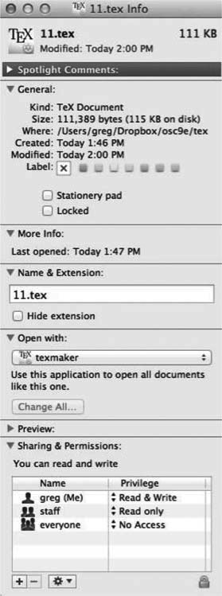
File info Window on Mac OS X

Slide 7
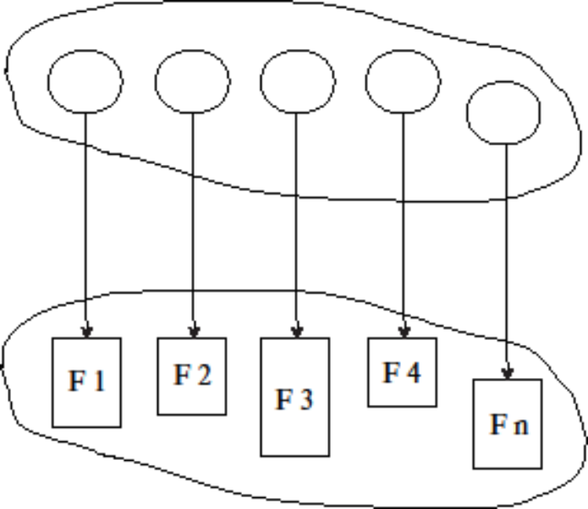
Directory Structure
A collection of nodes containing information about all files
Both the directory structure and the files reside on disk

Slide 8
File Operations
Create
Write – at write pointer location
Read – at read pointer location
Reposition within file - seek
Delete
Truncate
Open (F_{i}) – search the directory structure on disk for entry F_{i}, and move the content of entry to memory
Close (F_{i}) – move the content of entry F_{i} in memory to directory structure on disk

Slide 9
Access Methods 1
A file is fixed length logical records
Sequential Access
Direct Access
Other Access Methods

Slide 10
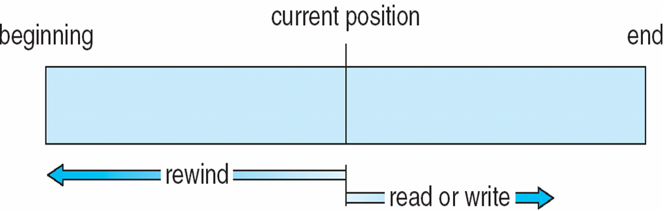
Sequential Access
Operations
  read next
  write next
  Reset
  no read after last write (rewrite)
Figure

Slide 11
Direct Access
Operations
  read n
  write n
  position to n
    read next
    write next
    rewrite n
n = relative block number
Relative block numbers allow OS to decide where file should be placed

Slide 12
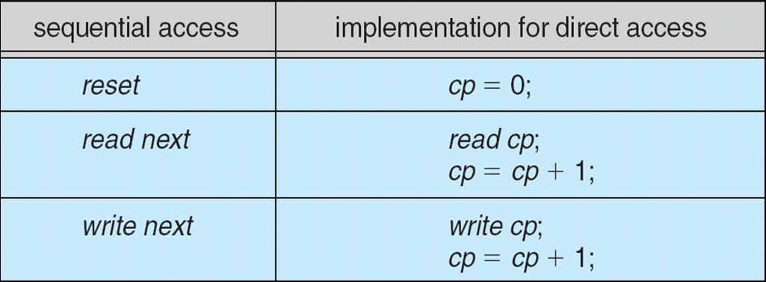
Simulation of Sequential Access on Direct-access File

Slide 13
Directory Structure
A collection of nodes containing information about all files
Both the directory structure and the files reside on disk

Slide 14
Operations Performed on Directory
Search for a file
Create a file
Delete a file
List a directory
Rename a file
Traverse the file system

Slide 15
Directory Organization
The directory is organized logically to obtain
Efficiency – locating a file quickly
Naming – convenient to users
  Two users can have same name for different files
  The same file can have several different names
Grouping – logical grouping of files by properties, (e.g., all Java programs, all games, …)

Slide 16
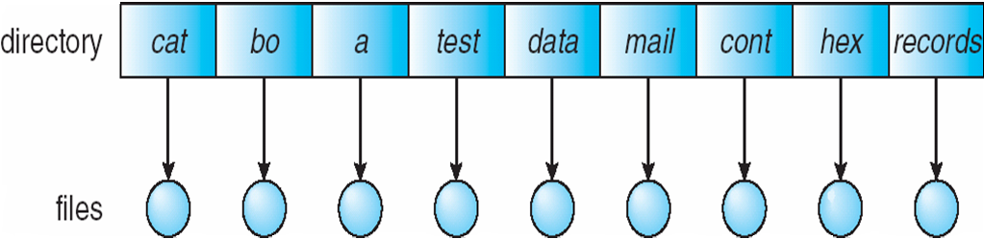
Single-Level Directory
A single directory for all users
Naming problem
Grouping problem

Slide 17
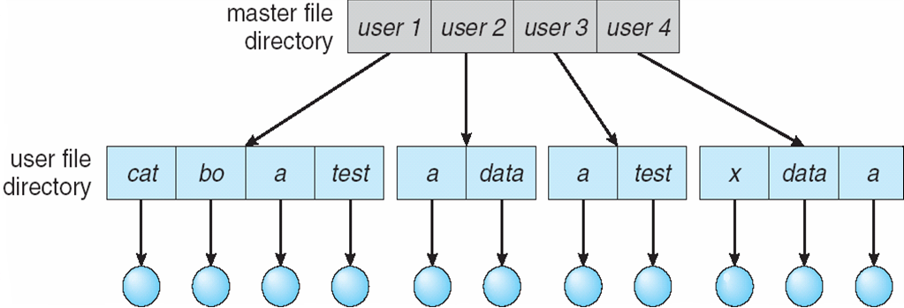
Two-Level Directory
Separate directory for each user
Path name
Can have the same file name for different user
Efficient searching
No grouping capability

Slide 18
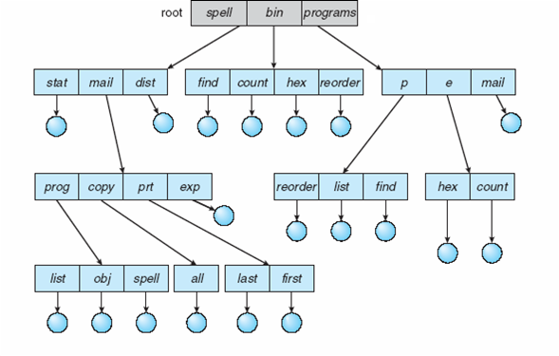
Tree-Structured Directories

Slide 19
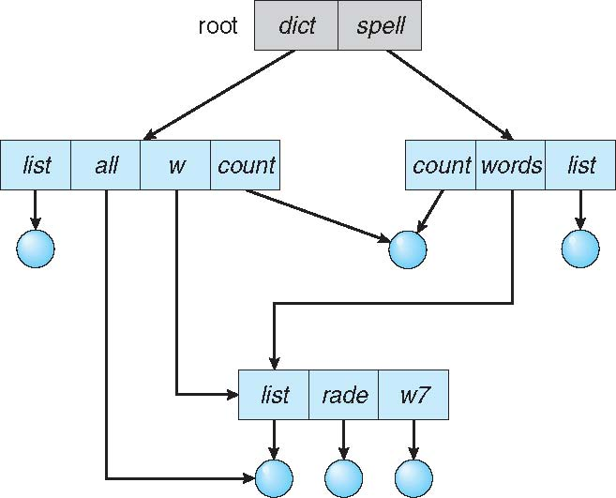
Acyclic-Graph Directories
Have shared subdirectories and files
Example

Slide 20
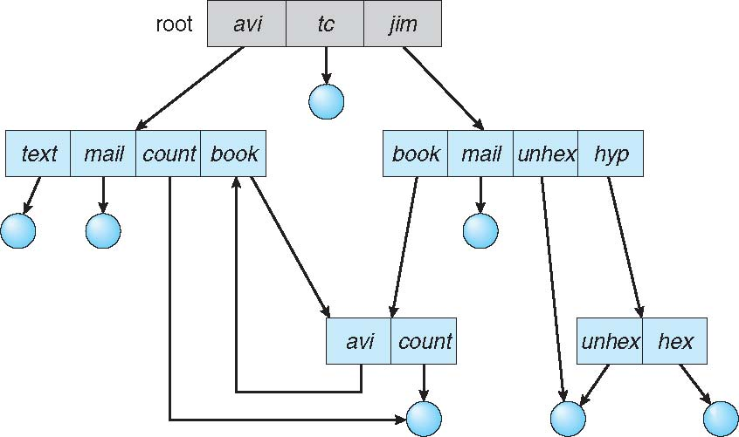
General Graph Directory

Slide 21
End of Chapter 13

